Slide 1
Investment Survey
A quick look

Slide 2
Assignment
(Hope I have this correct)
We were assigned a database.
Use Cloud Azure to process this database as a means of introducing us to Cloud Azure.
  Use Azure Data Factory to create Datalake.
  Use Azure Spark to create Data Warehouse.
  Use Azure Synapse to create Data Mart.
  Connect SQL with Azure Synapse to backup data.
  Connect PowerBI with Azure Synapse.
Create a PowerBI presentation of this database after it has been processed through Cloud Azure.

Slide 3
Assignment 1
The bits accomplished
  Use Azure Data Factory to create Datalake. Accomplished
  Use Azure Spark to create Data Warehouse. Accomplished
  Use Azure Synapse to create Data Mart. Accomplished

Slide 4
However
  Connect SQL with Azure Synapse to backup data. Unsure
  Connect PowerBI with Azure Synapse. Kind of.
My Explanation/Excuses
My free trial/credit subscription had run out in Azure Cloud.
Purchased a Pay-as-you-go plan to finish project.
After pushing my database in Cloud Azure and into PowerBI, closed my account in Cloud Azure completely.
RESULT: My database was in Cloud Azure and WAS connected to Power BI, but since I closed my Cloud Azure account, I was no longer able to access the database through Cloud Azure and Power BI.
REMEDY. I have proof that my project did go through Cloud Azure and into Power BI before I closed my Cloud Azure account.
Had to do the Power BI presentation with the original data in csv format.

Slide 5
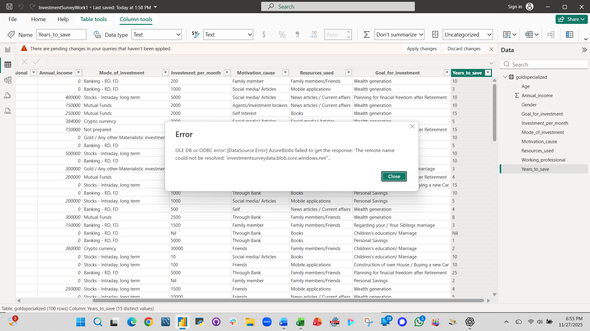
My database did go through to Power BI

Slide 6
My database did go through to Power BI
ChatGPT said:
Thanks for sharing the screenshot — now I can see the exact error:
**OLE DB or ODBC error: [DataSource.Error] AzureBlobs failed to get the response:
‘The remote name could not be resolved: investmentsurveydata.blob.core.windows.net’**
This error means Power BI cannot reach your Azure Blob Storage account.
It is not a Power BI transformation problem — it’s a connection problem.
✅ What the error really means
Power BI is trying to read the file again (because you made changes in Power Query).
But when it tries to reach your blob container, the storage account name:
investmentsurveydata.blob.core.windows.net
does not exist or can’t be found.
So Power BI can't refresh the original data source.

Slide 7
My database did go through to Power BI
You said:
I have closed my Azure account.
ChatGPT said:
Ah — that explains everything.
Once you closed your Azure account, your storage account:
investmentsurveydata.blob.core.windows.net
was deleted.
Power BI is still trying to load the original file from Azure Blob Storage, but the source no longer exists — so Power BI throws the connection error.

Slide 8
Going Forward
Since I could no longer access my transformed data in PowerBI through Cloud Azure
  I opened the data in Power BI through my local source and proceeded to process the data as I would have done through the Azure transformed data .

Slide 9
The Investment Survey

Slide 10
n = 100 | Variables = 10
Unknown:
  Source of survey data.
  How representative is data.
  Which population does data represent.
*For the purposes of this assignment, this survey will be taken as being representative of a general population in the USA.
*Most likely, from questions asked, this may be an Asian population

Slide 11
Demographics (n)
 | Male | Female | Total
Count | 64 | 36 | 100
Working | 25 | 20 | 45
Not working | 39 | 16 | 55
Age (years) | 18 – 56 | 18 - 45 | 100
Annual Income | $0 - $600,000 | $0 - $400,000 | 100

Slide 12
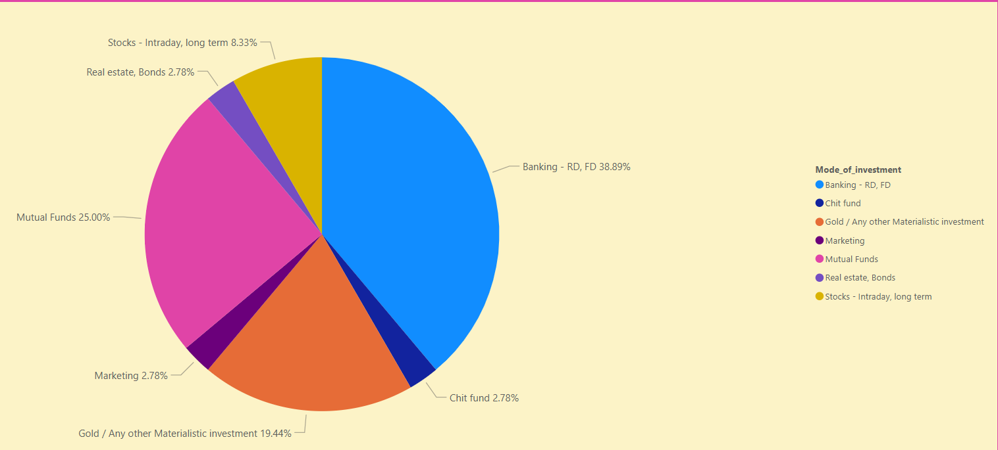
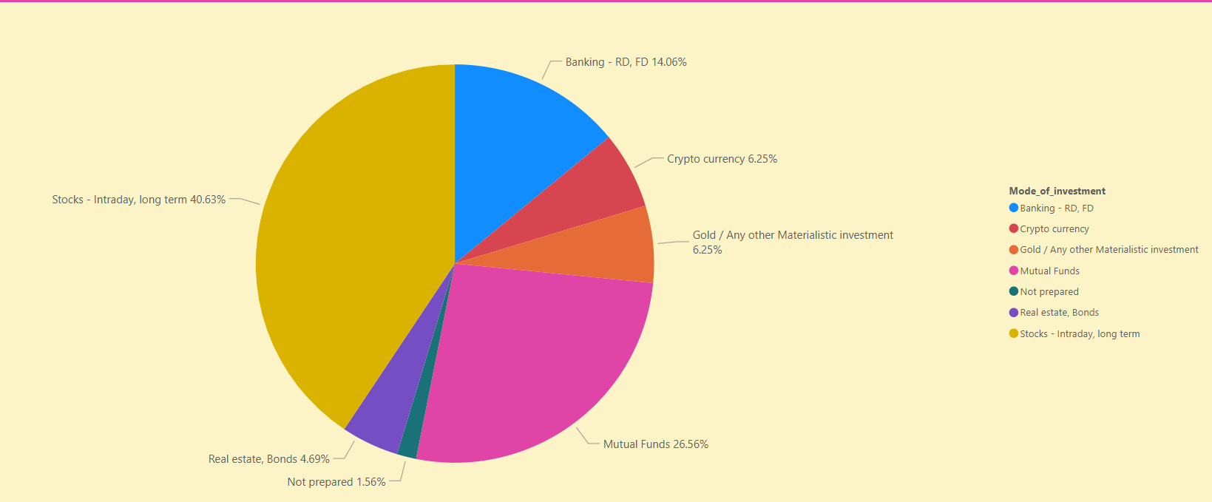
Investment Mode
Female
 | Male % | Female %
Banking | 14.06 | 38.89
Gold/Materials investment | 6.25 | 19.44
Stocks | 40.63 | 8.33
Mutual Funds | 26.56 | 25
Women are significantly more likely to be cautious about investments than men and take a 'safer' approach:
  39% of women compared to 14% of men were more likely to invest in banks (savings).
  Women (19%) were significantly more likely than men (6%) to invest in more stable markets such as gold.
To emphasize that men were more likely to take risks in investment, men (41%) were significantly more likely than women (8%) to invest in volatile modes such as stocks.
Male

Slide 13
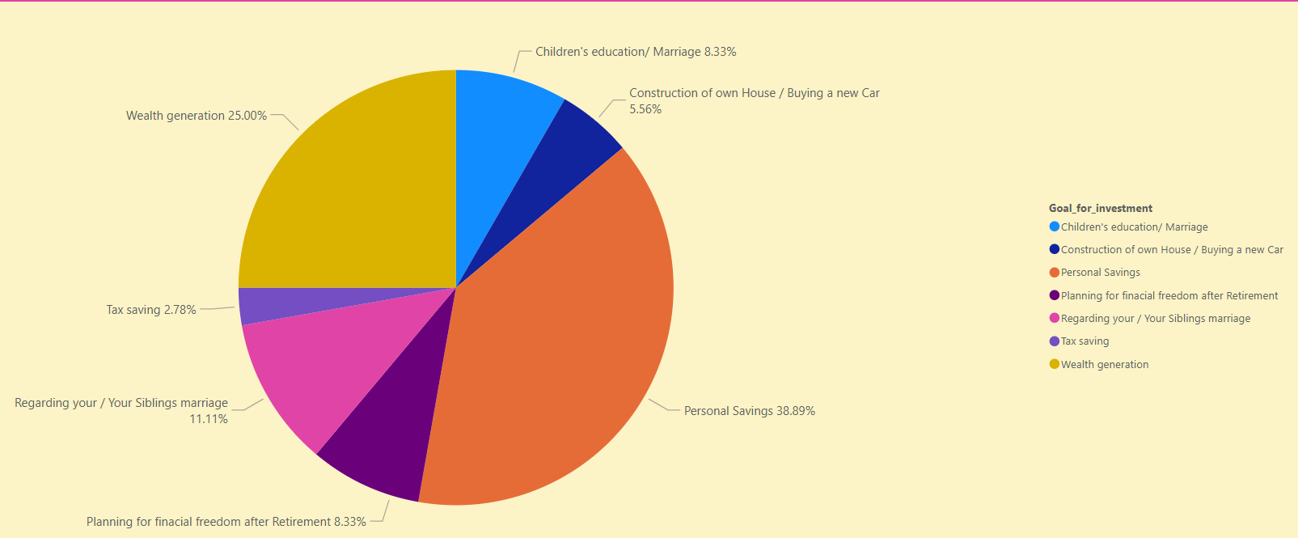
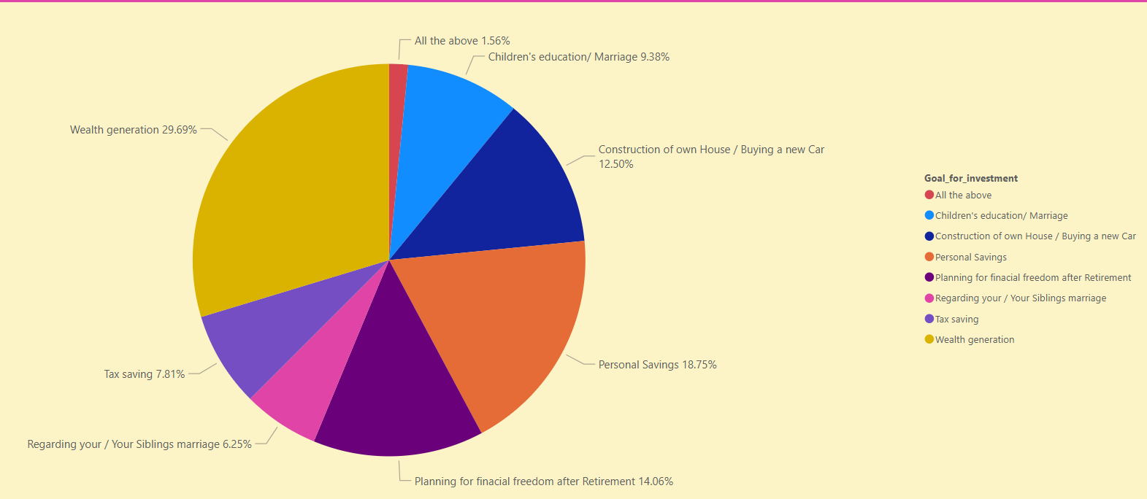
Investment Goal
Female
 | Men % | Women %
Personal savings | 18.75 | 38.89
Wealth Generation | 29.69 | 25
Your marriage/sibling's marriage | 6.25 | 11.11
Financial freedom after retirement | 14.06 | 8.33
Children's education/marriage | 9.38 | 8.33
Women were significantly (39%) more likely than men (19%) to have Personal Savings as their investment goal but less likely (25%) than men (30%) to have wealth generation as their investment goal.
11% of women were more likely than 6% of men to be saving for a marriage, whether it be one's own or a siblings
Men (14%) were more likely than women (8%) to have financial freedom after retirement as an investment goal.
Male

Slide 14
Motivation to Invest
Male
Female
 | Male % | Female %
Family | 7.81 | 52.78
Friends | 32.81 | 8.33
Through banks | 14.06 | 16.67
Social Media/articles | 23.44 | 8.33
Women are significantly more likely (53%) than men (8%) to be motivated by family to invest,
Men (33%) are more likely than women (8%) to be motivated by friends to invest.
Men are also far more likely (23%) than women (8 %) to be motivated by Social media/articles to invest.

Slide 15
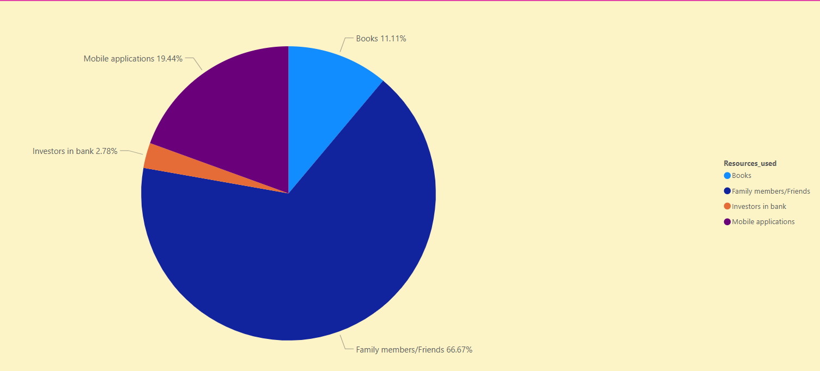
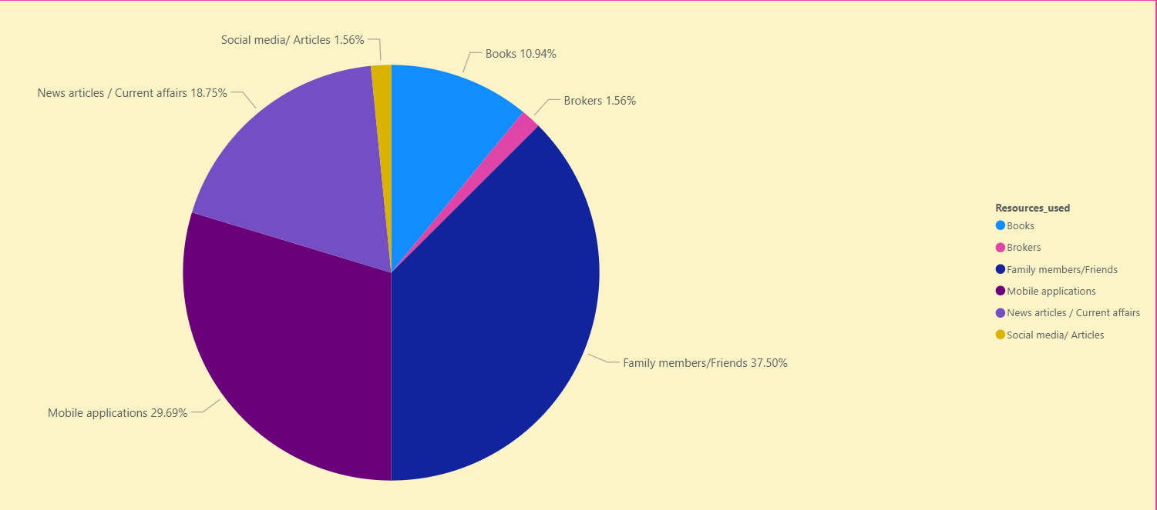
Resources used (advice on how/where to invest)
Female
 | Male % | Female %
Family members | 37.5 | 66.67
Mobile App | 29.69 | 19.44
News articles | 18.75 | 0
Male
Women (39%) significantly more likely than men (19%) to have Personal Savings as their investment goal
Women less likely (25%) than men (30%) to have wealth generation as their investment goal.
11% of women are more likely than 6% of men to be saving for a marriage, whether it be one's own or a siblings,
Men (14%) are more likely than women (8%) to have financial freedom after retirement as an investment goal.

Slide 16
Summary
Motivation to Invest
Investment goals
In this sample, women were significantly more likely (53%) than men (8%) to be motivated by family to invest,
Men (33%) were more likely than women (8%) to be motivated by friends to invest.
Men were also far more likely (23%) than women (8 %) to be motivated by Social media/articles
Women were significantly (39%) more likely than men (19%) to have Personal Savings as their investment goal but less likely (25%) than men (30%) to have wealth generation as their investment goal.
11% of women were more likely than 6% of men to be saving for a marriage, whether it be one's own or a siblings, and men (14%) were more likely than women (8%) to have financial freedom after retirement as an investment goal.

Slide 17
Summary
Modes of Investment
Resources (advice) used
Women are significantly more likely to be cautious about investments than men and take a 'safer' approach:
  39% of women compared to 14% of men were more likely to invest in banks (savings
  Women (19%) were significantly more likely than men (6%) to invest in precious materials such as gold.
To emphasize that men were more likely to take risks in investment, men (41%) were significantly more likely than women (8%) to invest in volatile modes such as stocks.
Women (39%) significantly more likely than men (19%) to have Personal Savings as their investment goal
Women less likely (25%) than men (30%) to have wealth generation as their investment goal.
11% of women were more likely than 6% of men to be saving for a marriage, whether it be one's own or a siblings,
Men (14%) were more likely than women (8%) to have financial freedom after retirement as an investment goal.

